Slide 1
Chapter 7: SAMPLING & PARTITIONING

Slide 2
Contents
Introduction to Sampling
Introduction to Partitioning
Partition Node
Random Partition
Stratified Partition

Slide 3
Introduction to Sampling
Sampling is using only a portion of your whole dataset:
Random sampling - usually done for performance reasons
If you have “big data”, you may pay a large time cost to build models on all records
Often done when importing data (or earlier) (helps save on memory and/or disk space)
However, with advanced machine learning models (like Neural Networks or Ensembles) it’s not uncommon to load data without memory problems, but have trouble at model training time - In this case, you can sample as part of data preparation
Stratified sampling is often done for technical reasons:
For example, you may wish to change the class balance of your data for training
Stratified sampling done as part of data preparation, after data is imported

Slide 4
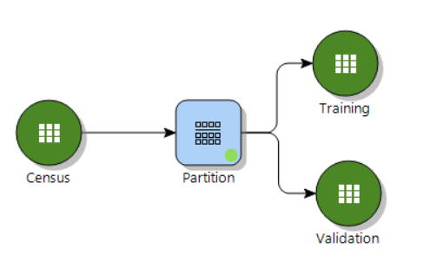
Introduction to Partitioning
Partitioning is when you take a dataset and split it up into several parts (other datasets), each of which can be used separately for different purposes
This is most commonly done for making Training/Validation partitions
Prior to building a model, data is split into separate partitions: for training and evaluating the model
Hold some records out of your training set to get a better idea of how your model performs on “new” data, to check for overfit
Records are randomly assigned to each partition typically without replacement, i.e. each record can only show up in one partition
Approaches:
Traditionally: create 2 partitions, Training/Validation - often 70/30 split or so
Models such as Deep Learning can benefit from 3 partitions (Training/Validation/Testing), with the Validation sample used to guard the model against overfit at training time

Slide 5
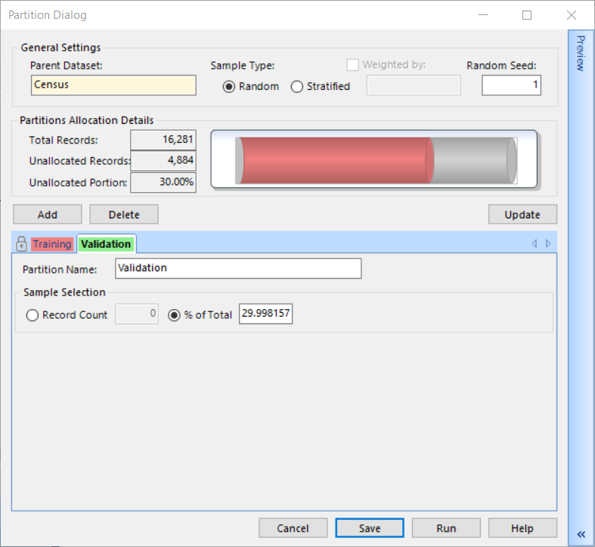
Partition Node Random Sample
Random sample: Records are selected from the dataset at random for each partition
Example shows 2 samples created (70% records in Training and approximately 30% records in Validation)
Each sample will create a new dataset on the canvas
Demo
Notes:
Trainer notes: demo one example of random sample with Training/Validation split with the traditional 70/30 record allocation

Slide 6
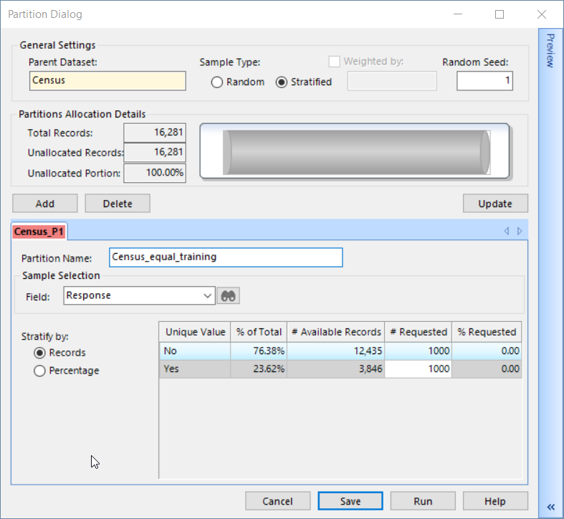
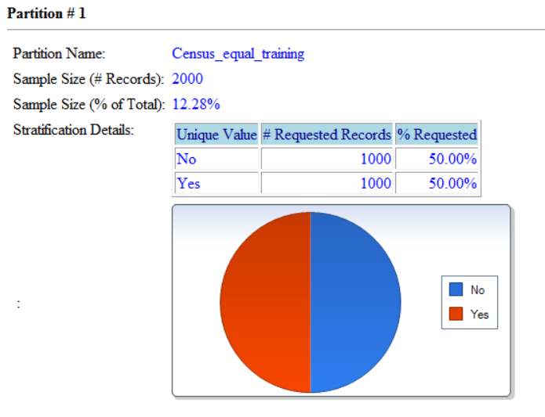
Partition Node Stratified Sample
Stratified sample: Samples chosen to meet a user-defined distribution of a selected field (called the stratification variable)
Example shows a sample stratified based on the Response variable created with 1000 records with the value No and 1000 records with the value Yes
Requested records will be randomly chosen from available records when possible (e.g. if requesting all records available, no random selection will occur)
Preview ribbon can be used to open report to spot check stratification details
Demo
Notes:
Trainer notes: demo stratified sample example, show difference between # requested and % requested

Slide 7
Chapter 7 Exercises (1/1)
Random Partitions:
Import the files Census.xlsx if it is not already in the project
Drag the Partition node from the Manipulate section of palette onto the Workflow canvas
Familiarize yourself with its functionality. Use the Help button!
Create two random partition of equal proportion:
Name them appropriately
Use the Update button to view allocations
Stratified Partitioning:
Create a stratified partition based on the variable relationship
Stratify by Records and ensure categories are equally represented with 100 records in each
Verify results using the Dataset Chart tab

